Slide 1


CIVILEN 5610.02 / FABE 5260.02 Safe Water on Tap AguaClara OSU and Honduras Recap

Slide 2

Activity
Draw four straight lines connecting all nine dots, without retracing any line or lifting your pen from the page.

Slide 3

Activity
Notes:
"most people think that they needed to stay within the box!" we make assumptions, and we aren't even aware that these assumptions are limiting us. Challenge your own assumption throughout this course.

Slide 4
Today’s Plan
Discussion
AguaClara OSU
Honduras 2023 Trip
Breakout room working session

Slide 5
Discussion #1 - Pair & Share
Prompt – Why providing high quality water (safe water on tap) can be more financially sustainable than providing river water on tap.

Slide 6
Discussion #2 - Pair & Share
Prompt – Do you agree with Dr. Gro Harlem Brundtland's assertion that technology isn't the problem. Why or Why not?

Slide 7
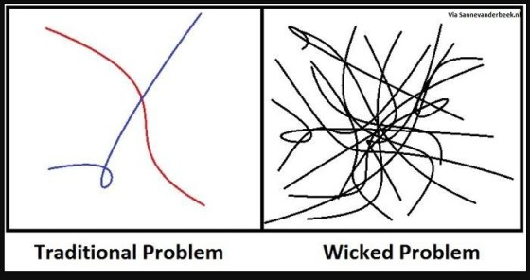
The Idea of Wicked Problems
Issues that are complex and without clear boundaries.
(1) they are dynamic complex systems with many interdependencies; and
(2) stakeholders have different values, interests and conceptions of the problem and solutions.
Notes:
Examples of Wicked problems – Climate Change, food insecurity, poverty

Slide 8
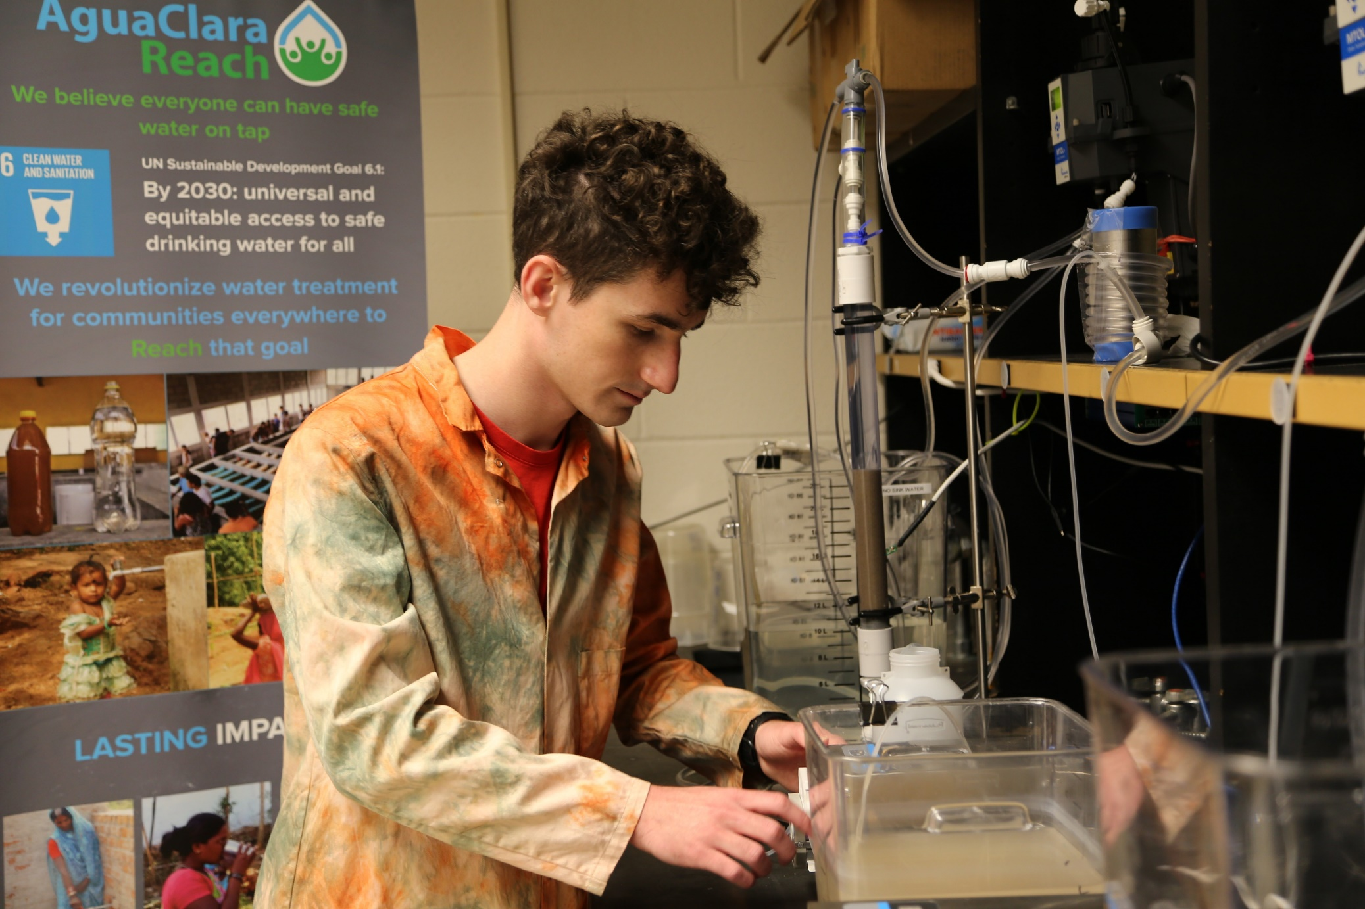

AguaClara OSU
Humanitarian Engineering Research
Passive gravity water treatment research in collaboration with AguaClara Reach, AguaClara Cornell, NJIT, Zamorano University.

Slide 9
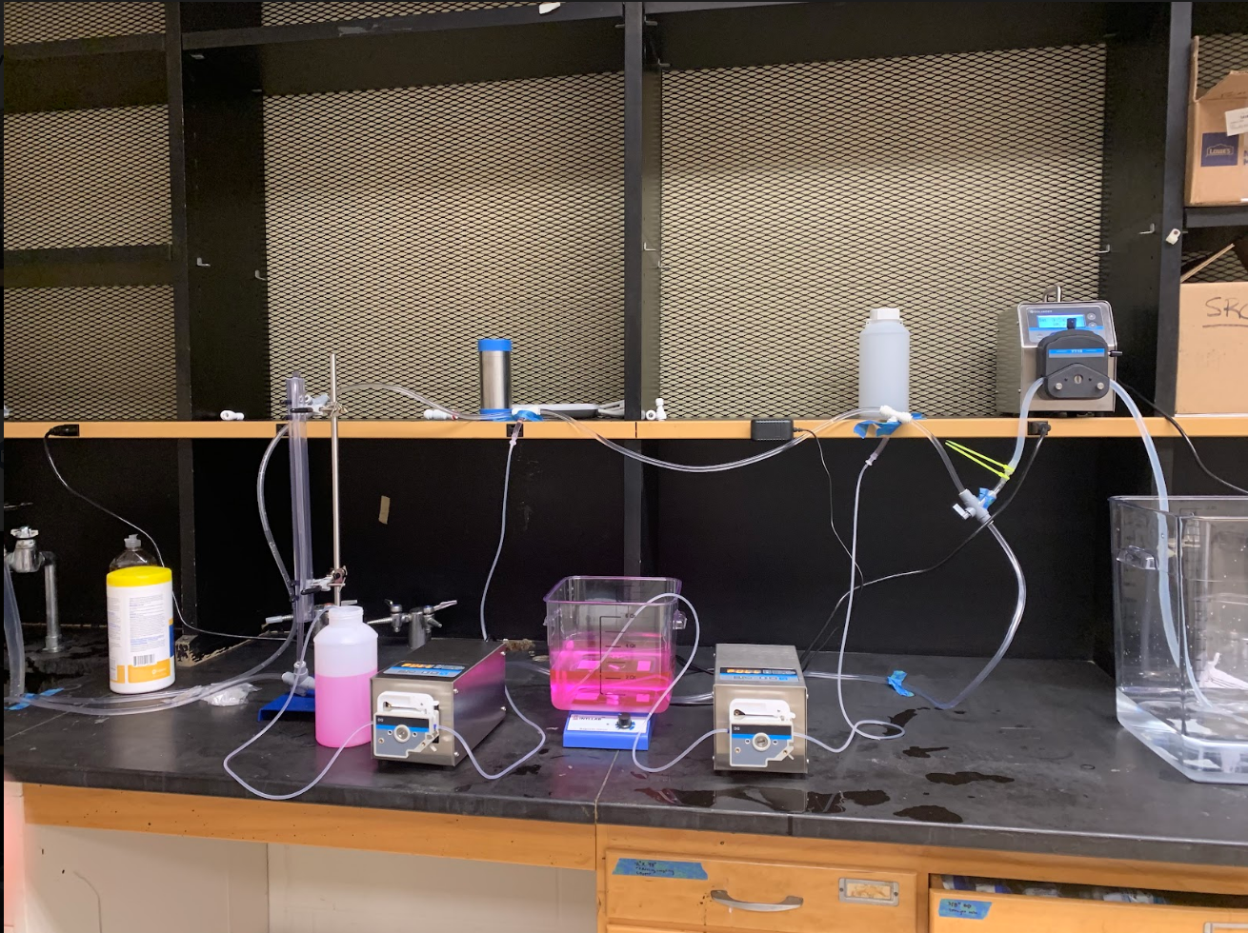
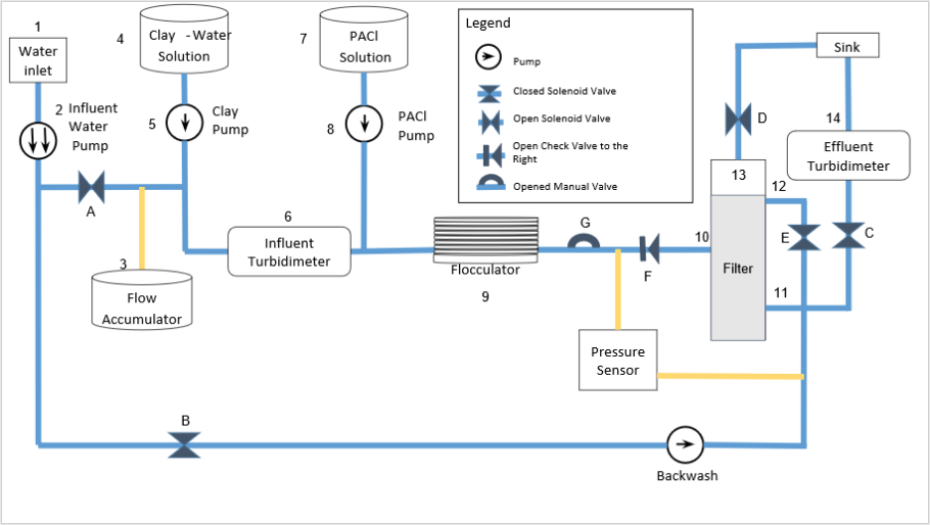
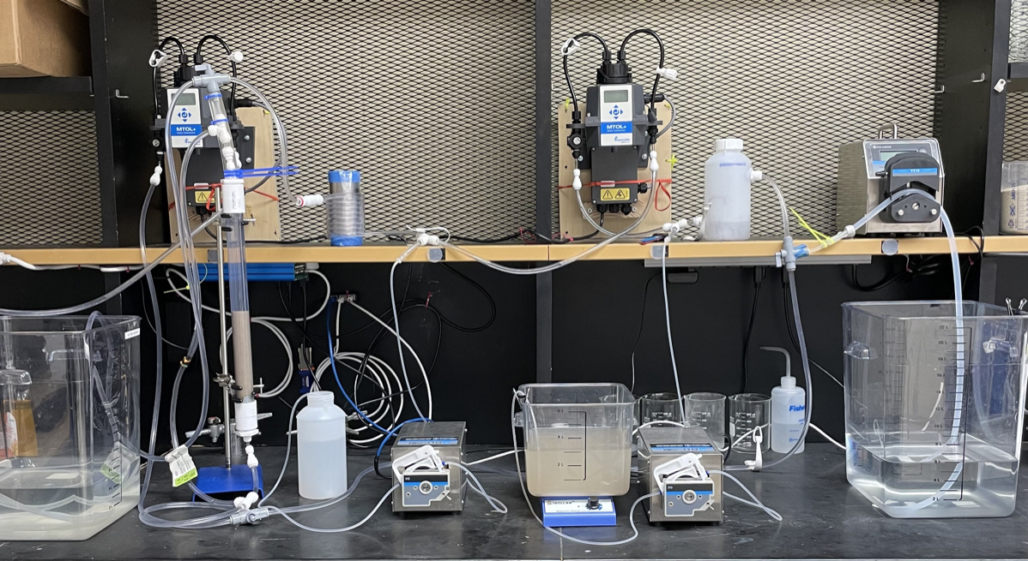
Sand Filtration Research
Spring 2021
Spring 2022

Slide 10
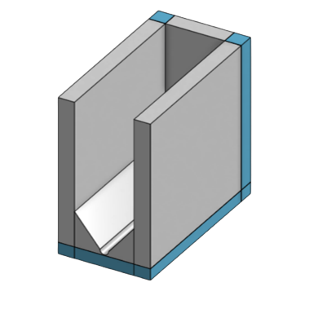
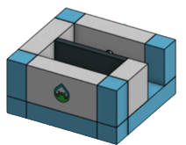
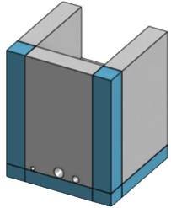
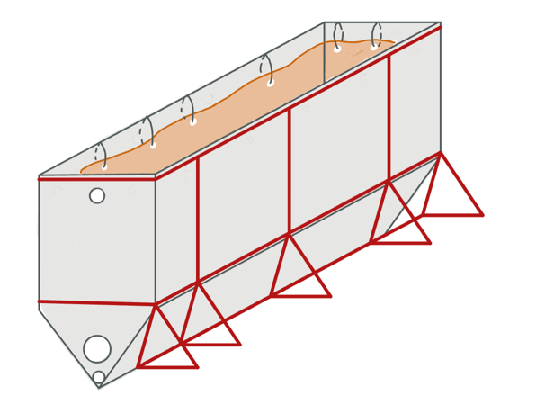

Global Capstone
Prefabrication
3D Concrete Printing
Automated Backflush Sensor

Slide 11
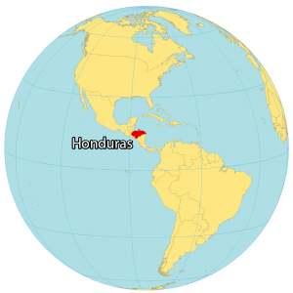

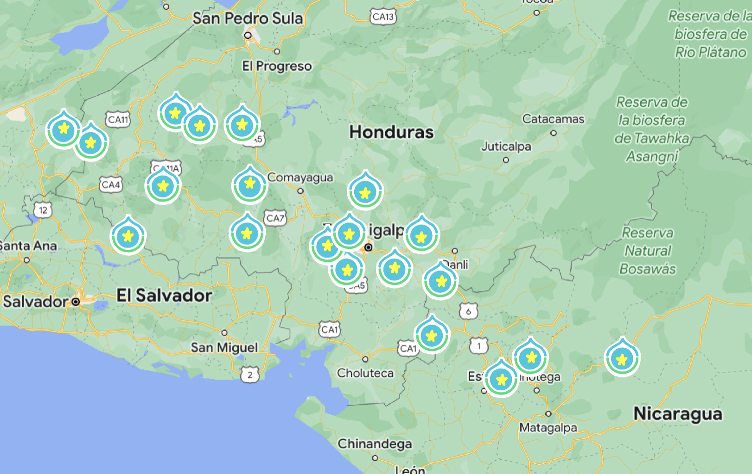


Honduras Trip
Notes:
Presenter: Howard
US University
In-country University
In-country Community Development NGO

Slide 12

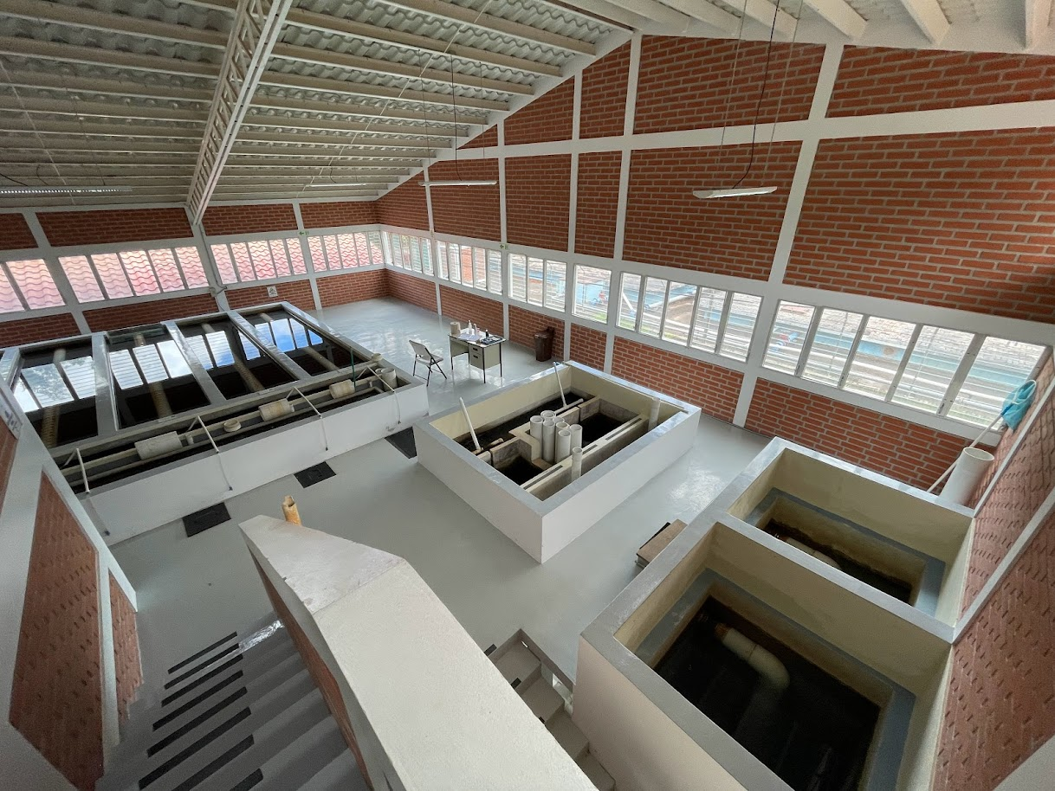
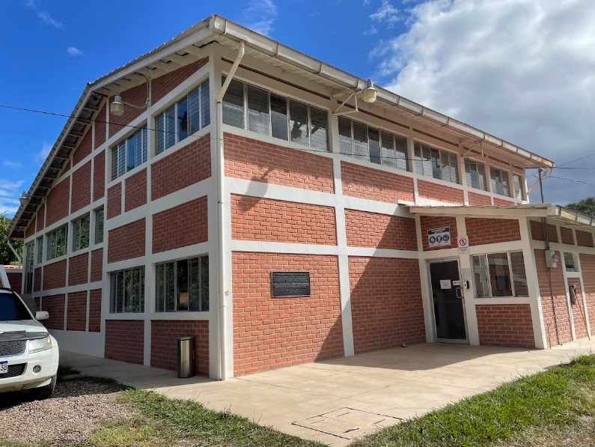
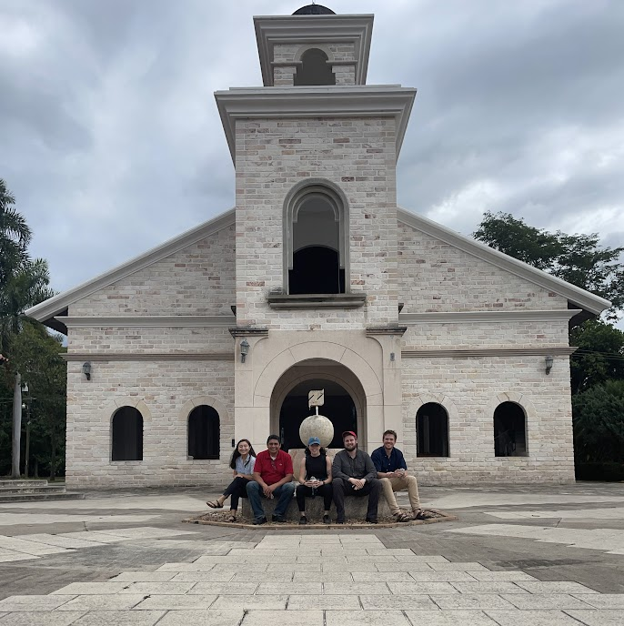
Zamorano
Who are they?
Agricultural/technical University
1200+ students from 12+ countries
Notes:
Presenter: Howard
“Learning by Doing”

Slide 13
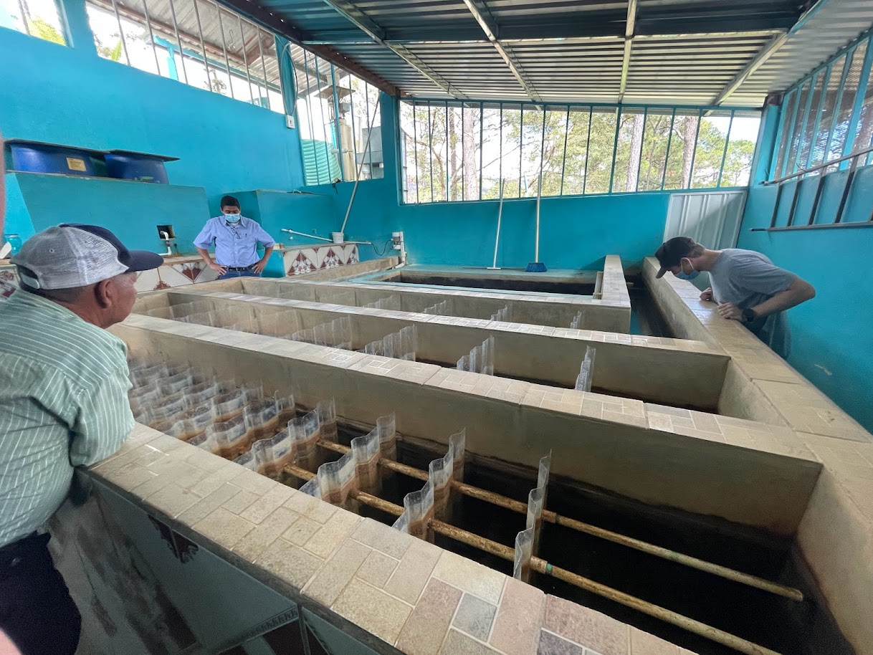
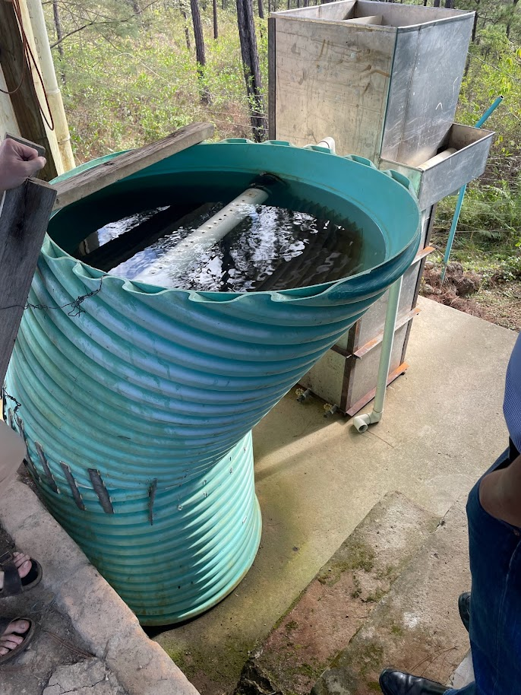
Plant - Four Communities
Notes:
Resiliency
2014
Planta LPS
Outgrown the community

Slide 14
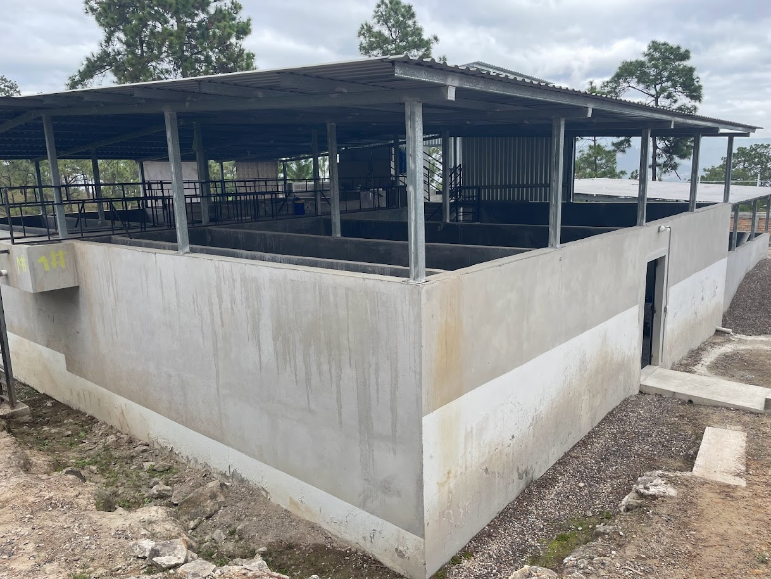
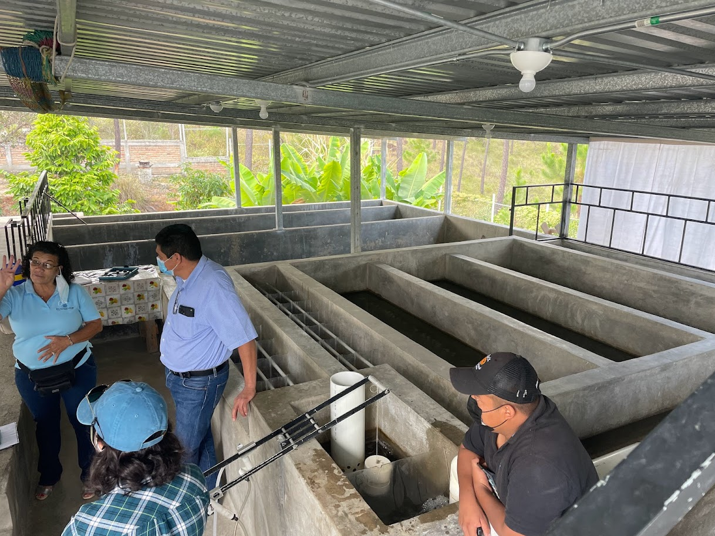
Plant - Divine Providence
Notes:
Efficiency

Slide 15
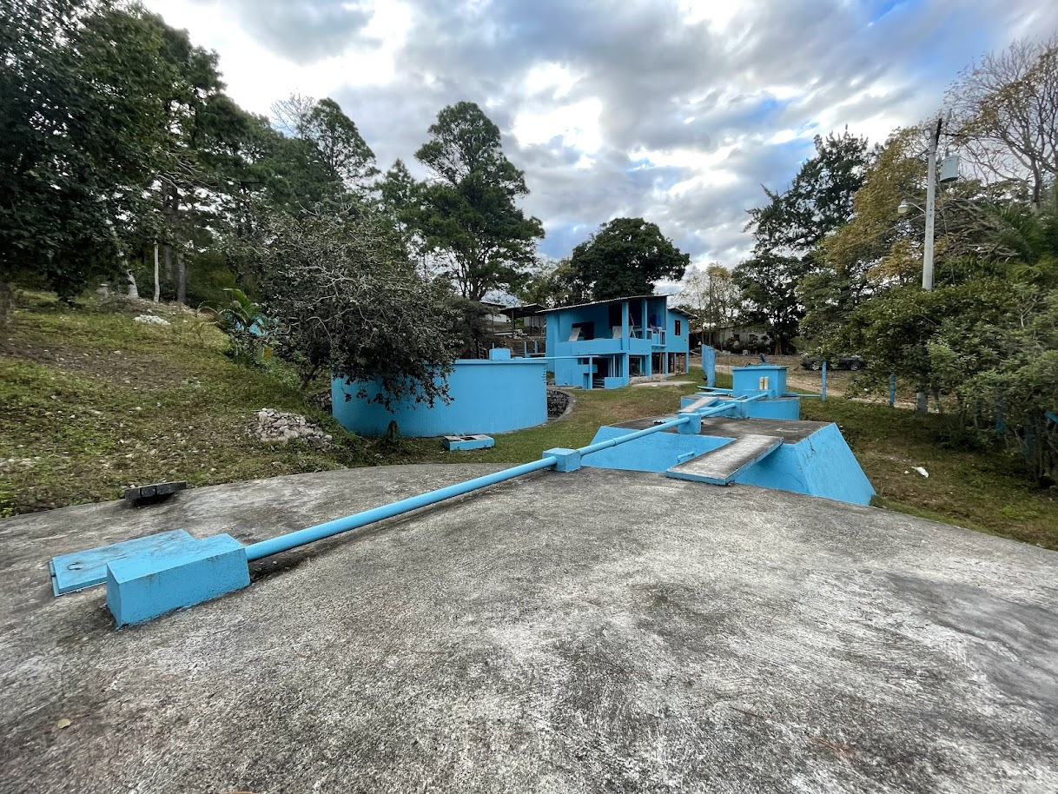
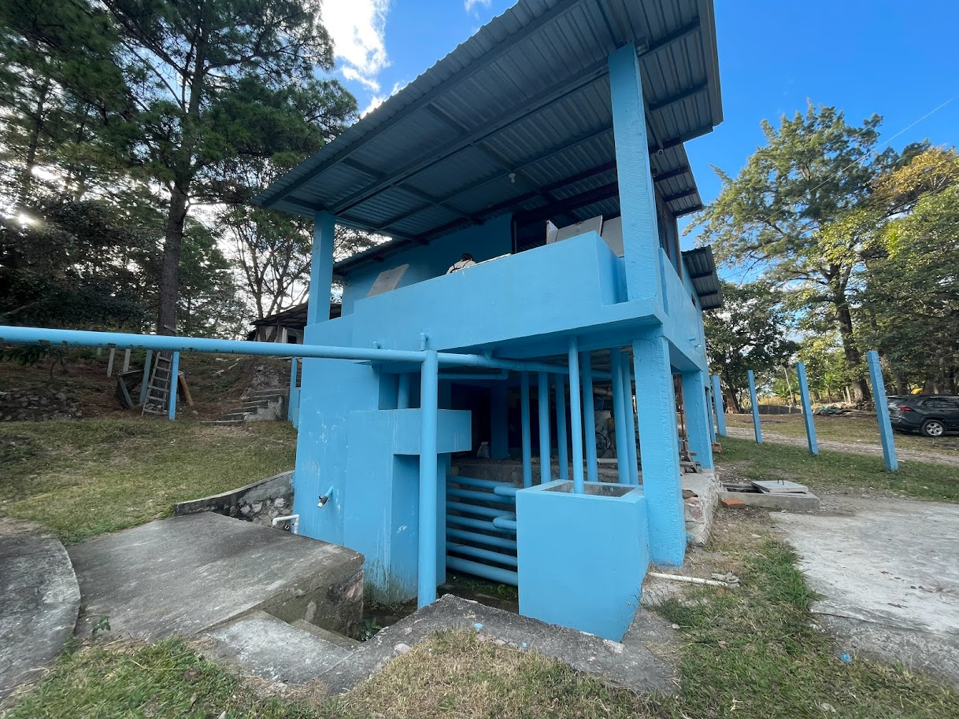
Plant - Tamara

Slide 16
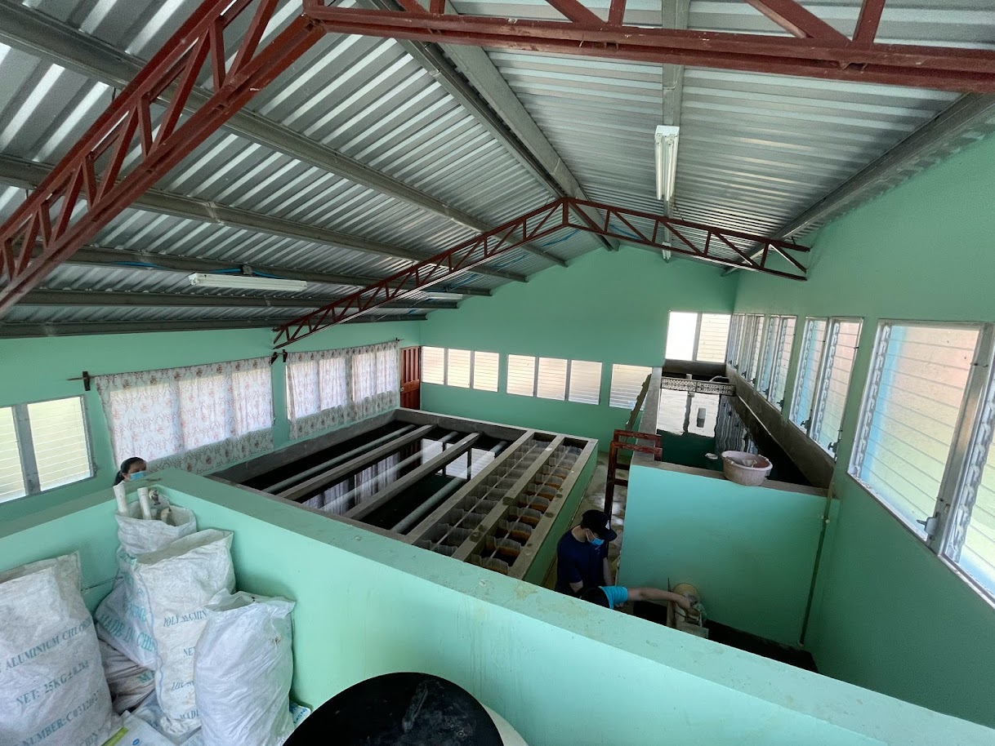
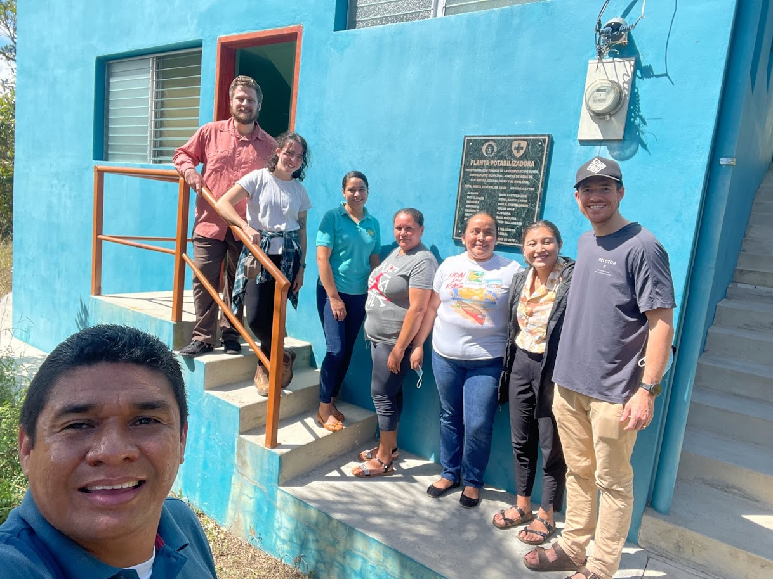
Plant - San Matias

Slide 17
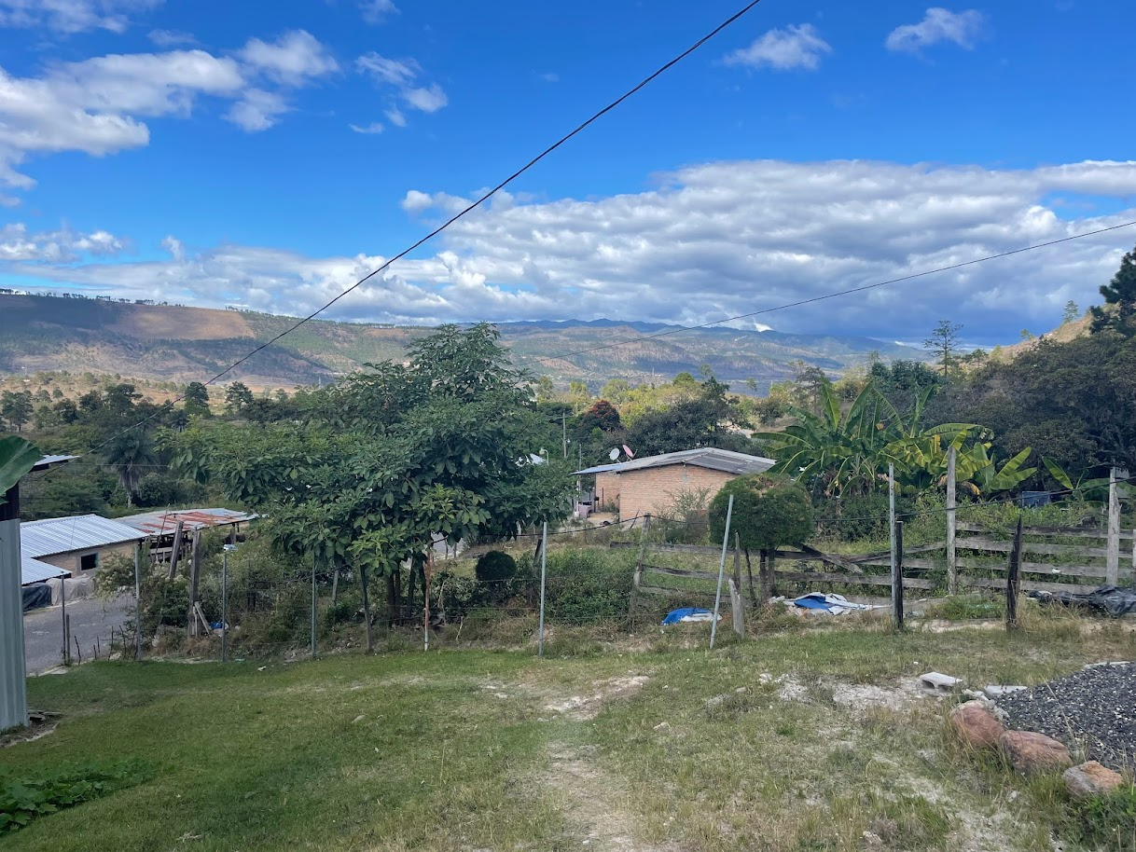
Hospital

Slide 18
Takeaways
Impact of the plants
Insights of the plant operators
Importance of local partners

Slide 19
Questions, Comments?

Slide 20
Breakout

